Slide 1
Demographic monitoring to detect climate change impacts on threatened populations
Bruce E. Kendall
Elizabeth H. Hiroyasu
Bren School of Environmental Science & Management
University of California, Santa Barbara

Slide 2
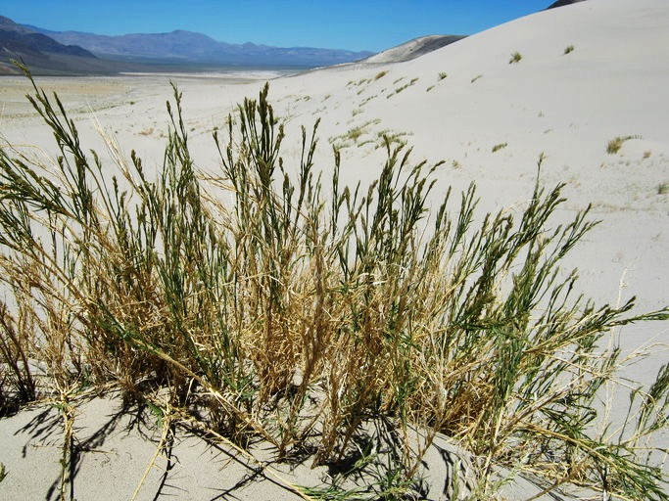


Changing climate may affect survival or fecundity of T&E species
Eureka Valley dune grass
CalPhoto
Notes:
I was recently asked to review a downlisting proposal for a rare desert plant. The threats that had triggered the original US Endangered Species Act listing had been mitigated, but there was new concern that the species might be threatened by climate change. This is a long-lived species with highly variable reproduction, and abundance monitoring had produced wildly fluctuating estimates of population growth rates from which it would be nearly impossible to identify a long-term trend towards worsening conditions, even if those conditions were directly affecting survival or reproduction.
This got me to wondering: is there a more powerful monitoring approach for identifying the demographic impacts of a changing environment?

Slide 3
We care about abundance, but it doesn’t give a clear signal of changing demography
Notes:
Since abundance is what we ultimately care about, it is really tempting to monitor that, as had been done for the Eureka dune grass. But it’s hard to interpret changes in abundance trends – in this example are we merely seeing constant exponential declines, or are conditions getting worse through time?

Slide 4
Linear demographic trends create quadratic trends in log(abundance)
Notes:
Because exponential growth or decline creates a straight-line trend in log(abundance), changing demography will create a second-order trend, curving up for improving conditions and curving down for declining conditions.
However, quadratic trends are difficult to identify with limited data.

Slide 5
Linear demographic trends create linear trends in population growth rate
Notes:
From a time series of abundances, we can calculate population growth rates. Any positive or negative trend in demography will create a similar trend in population growth rate – a much simpler signal to detect!
This would seem to be the way to proceed … but remember my experience of growth rate fluctuations in Eureka Valley dune grass!

Slide 6
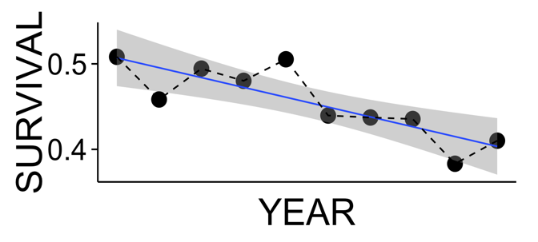
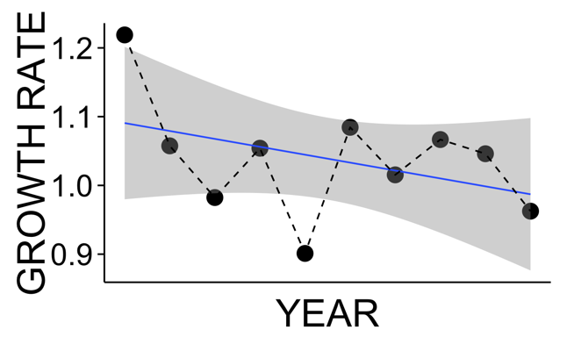
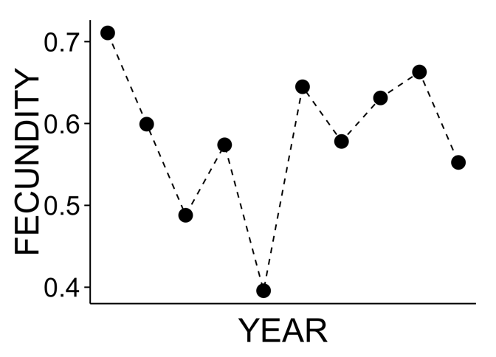
Trends in one demographic rate can be obscured by variability in another
P = 0.003
P = 0.237
Notes:
A clear trend in one demographic rate, such as survival, may be accompanied by high variability in another demographic rate, such as fecundity. Since population growth rate depends on both demographic rates, the trend in population growth rate may be difficult to detect without many decades of monitoring.

Slide 7


Demographic monitoring seems more powerful—should we use it?
© BrokenSphere / Wikimedia Commons
Notes:
All else equal, then, it seems that monitoring demography is better than monitoring abundance. But demographic monitoring takes a lot of work—capturing, marking, and resighting individuals—it’s much cheaper and easier to simply count individuals.
Thus we need to know how much better demographic monitoring is than abundance monitoring for detecting trends in conditions. That is the issue we address in this research.

Slide 8

We performed a simulation study using “realistic” populations
[2005]
Simulate!
– 0
[2002]
– 0.01
[2001]
– 0.02
[2001]
[2004]
– 0.03
[2002]
Randomize
[2001]
– 0.04
[2003]
[2004]
– 0.05
[2004]
[2004]
Data
– 0.06
[2001]
[2005]
– 0.07
[2004]
– 0.08
Salguero-Gomez et al. (2015)
J. Ecol. 103: 202
www.compadre-db.org
[2003]
– 0.09
Notes:
We did not study either penguins or dune grass, but instead took advantage of the COMPADRE plant matrix database to examine patterns across a range of plant species. For this talk we focused on populations of herbaceous perennial plants in the COMPADRE plant matrix database that had at least three stages and at least five years of data.
The data are a sequence of annual demographic matrices containing survival, fecundity, and growth.
To simulate environmental variability we randomized the matrices; on average these random sequences have no demographic trends.
We then imposed a demographic trend by reducing survival by 1 percent each year.
We simulated each replicate for 10 years.

Slide 9
We estimated trends in both survival and growth rate
“Demographic monitoring”
P = 0.003
“Abundance monitoring”
P = 0.237
Notes:
For each replicate we used linear regression to estimate the linear trend in survival, which I will call “demographic monitoring”.
We did the same to estimate the linear trend in population growth rate, which I will call “abundance monitoring” because growth rate is calculated from the time series of total abundance.
In both cases we recorded the P value as an index of the statistical evidence for the trend—small P-values mean that we are confident that conditions are changing.

Slide 10
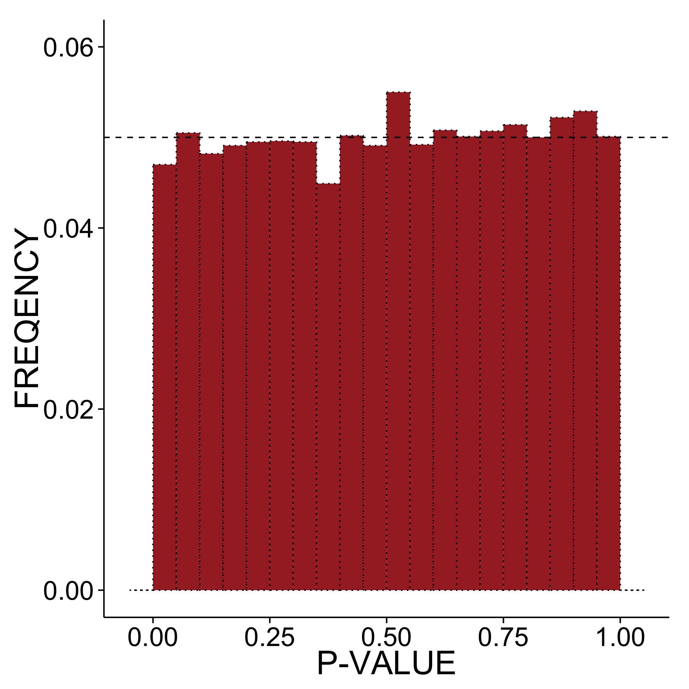
We compare P-value distributions of demographic & abundance regressions
Notes:
For each population we performed 10,000 simulations, giving us 10,000 pairs of P-values. This graph shows what we would expect to see if there were no trends in the data, with each P value being equally likely. The bins of the histogram have width 0.05, so the null expectation is that each bar should contain 5% of the replicates, as shown by the dashed line.

Slide 11
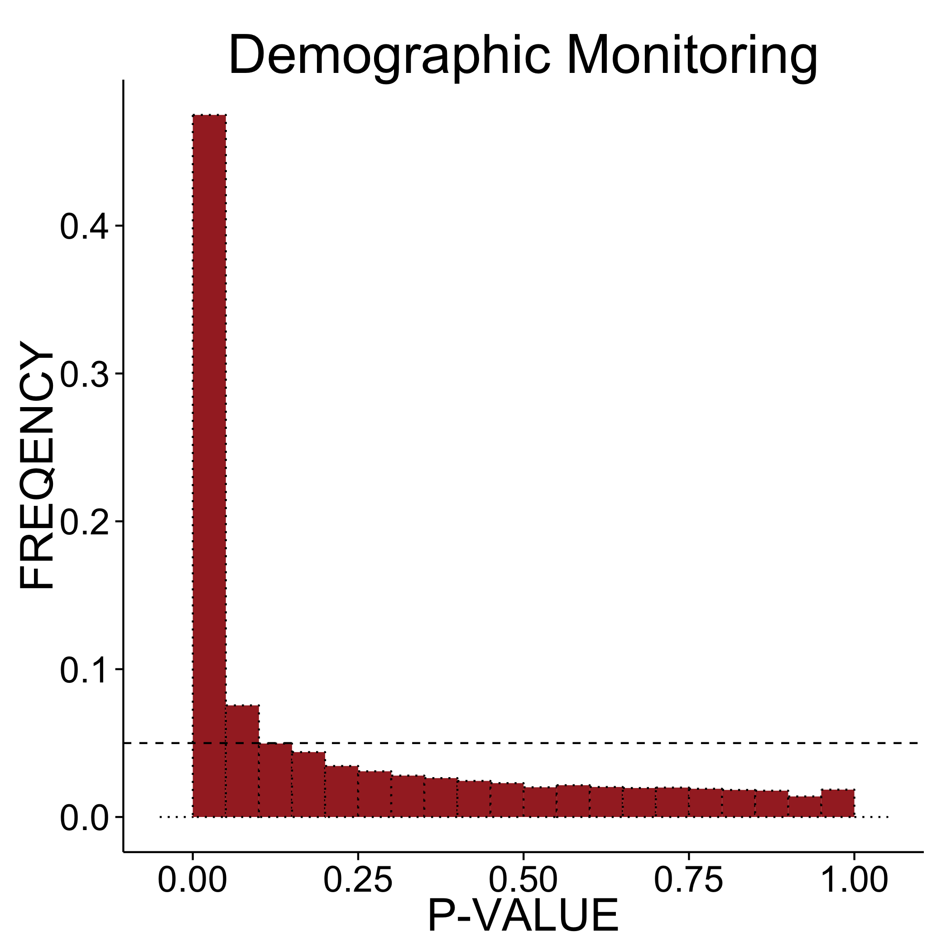
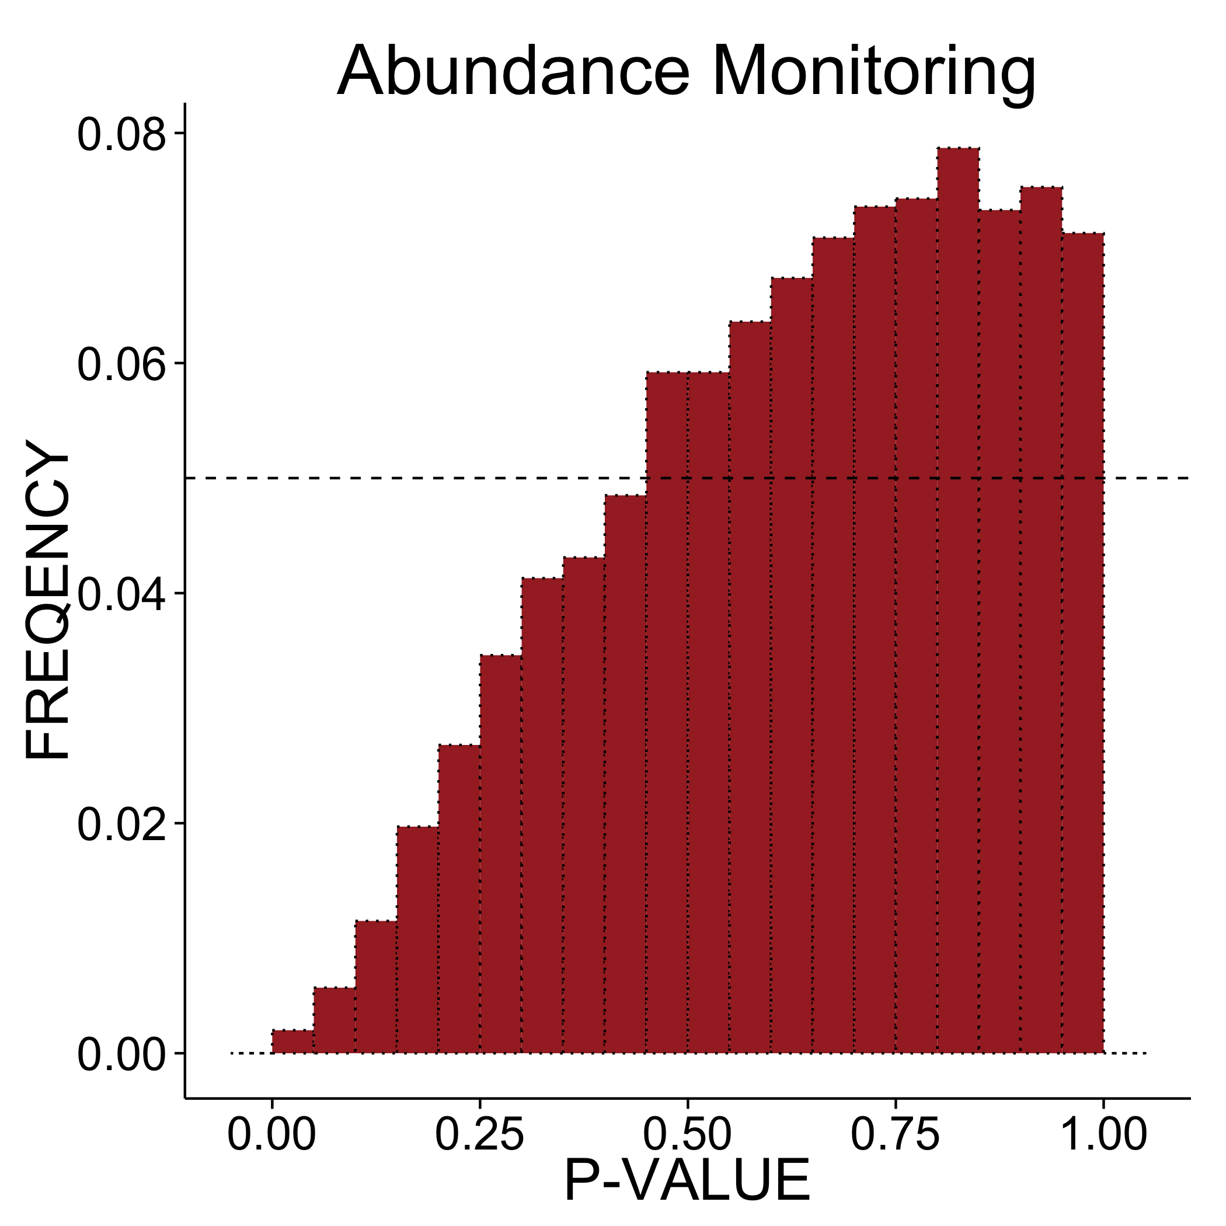
Common result: low demographic P-values, high abundance P-values
Notes:
Here is the result for one of our populations. Nearly half of the replicates gave a P-value less than 0.05 under demographic monitoring, shown on the left. In contrast, for abundance monitoring the majority of replicates gave a P-value greater than one half.
Thus, given a typical alpha level of 0.05 or 0.1, we would have a good chance of detecting the trend if we were monitoring survival directly, but a very poor chance of detecting the trend if we were simply monitoring abundance. For a given alpha level, the fraction of simulated P-values below that level tell us the power of the technique.

Slide 12
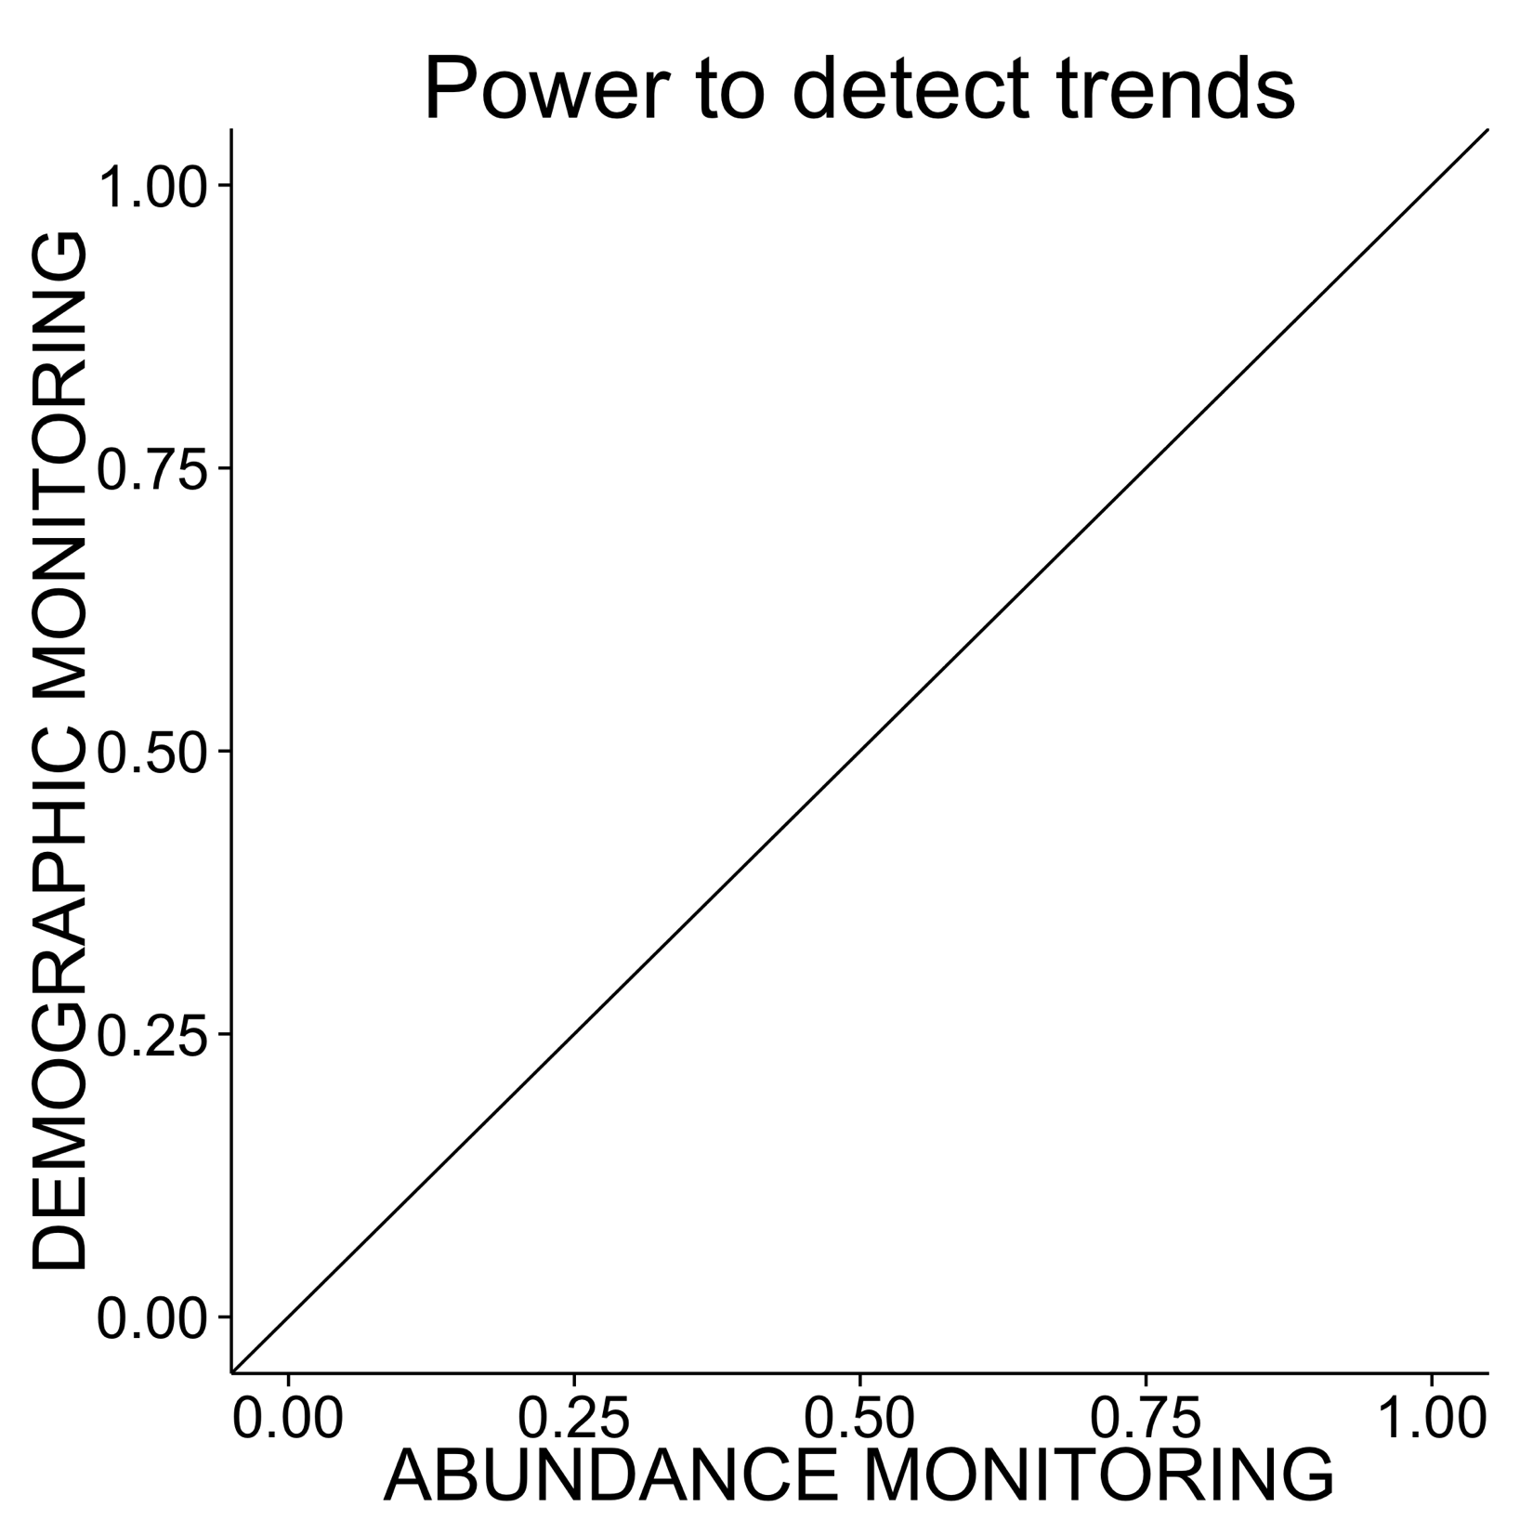
Compare power of demographic & abundance monitoring
Notes:
I’m now going to show you a synthesis across all 83 populations that we analyzed. For each, we calculated the power at an alpha of 0.1; that is, the fraction of P values that were less than 0.1. The power of abundance monitoring is on the horizontal axis, and the power of demographic monitoring is on the vertical axis. High power is good, so populations for which demographic monitoring is superior will be above the diagonal line.

Slide 13
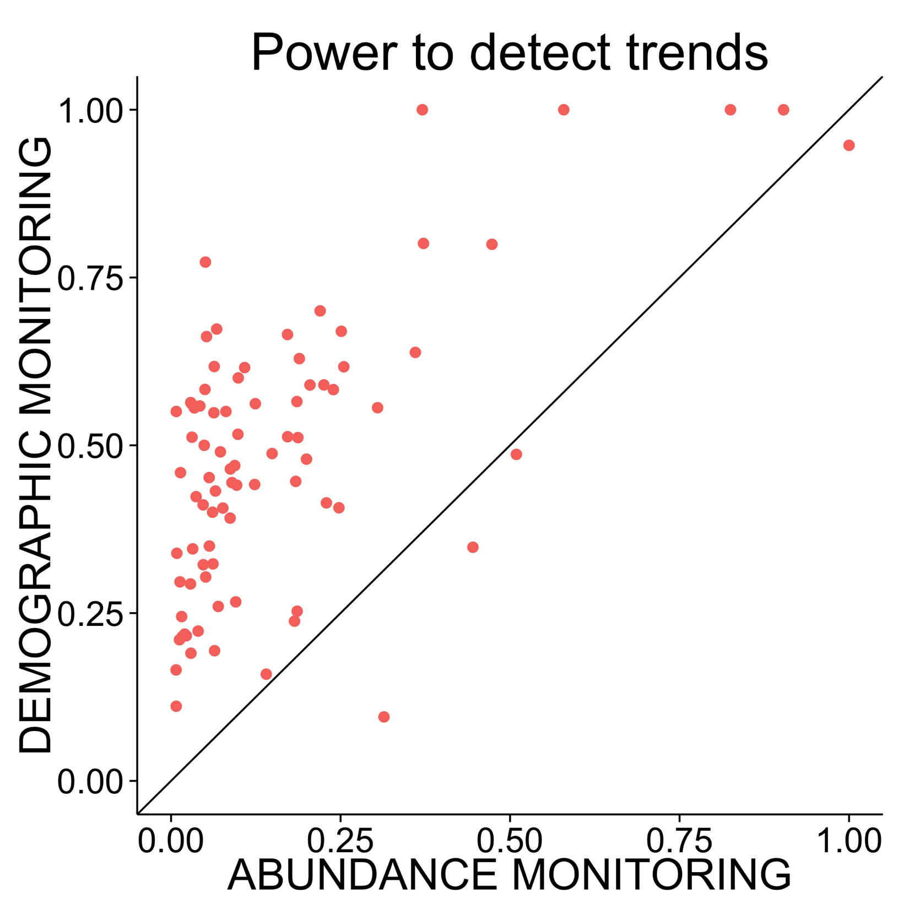
Demographic monitoring usually has higher power
Notes:
Each of these points is a population; 83 populations from 38 species are represented.
Overall, 95% of the populations had more power to detect the trend under demographic monitoring than under abundance monitoring. Furthermore, the power under abundance monitoring was often lower than we would expect even as a false positive rate in the absence of any trend!
These results indicate that demographic monitoring may be worthwhile across a large range of plant species. However, …

Slide 14
Demographic monitoring usually has higher power, but what about…
Measurement effort
Measurement error
Predicting magnitude of the difference
Notes:
We still need to explicitly account for the higher costs of demographic monitoring.
Furthermore, in our analyses so far we have assumed that both annual survival and annual abundance were measured perfectly. Real world measurement error will reduce the power of both approaches, and the returns to additional sampling effort may be very different for the two monitoring programs.
Finally, we see substantial variation among species and populations in the relative power of demographic and abundance monitoring. To be truly useful for conservation monitoring, we need to know the characteristics of populations that will benefit most from demographic monitoring.
These are all topics of ongoing research, and their resolution should provide a clear picture of when to use demographic monitoring to track climate change impacts on rare species.

Slide 15
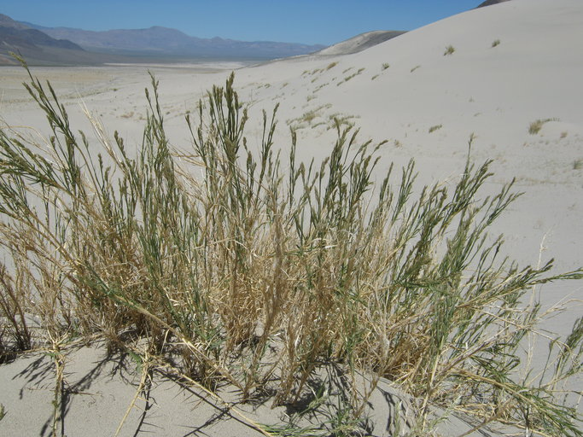
Thank you!
Helpful people
Gordon Fox
Jonathan Levine
ETH Plant Ecology Lab
Funding agencies
NSF
UCSB
Notes:
Thank you very much, and I’ll be happy to take any questions!

Slide 17
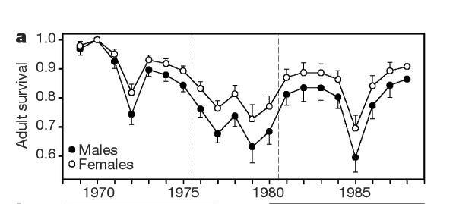
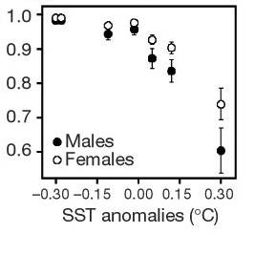
Changing climate may affect survival or fecundity of T&E species
Adult survival of emperor penguins declines with
warmer temperatures
Barbraud & Weimerskirch (2001) Nature 411: 183
Notes:
Because temperature and rainfall affect the demography of many species, climate change may create trends in survival or fecundity of threatened and endangered species.
This was documented, for example, in a long term study of emperor penguins, in which adult survival declined through time as a consequence of increasingly warm sea surface temperature.
How can we best monitor a population to assess whether this is happening?
I was recently asked to review a downlisting proposal for a rare desert plant. The threats that had triggered the original US Endangered Species Act had been mitigated, but there was new concern that the species might be threatened by climate change

